Slide 1
MATLAB for Engineering Applications Fifth Edition
William J. Palm III
© McGraw Hill LLC. All rights reserved. No reproduction or distribution without the prior written consent of McGraw Hill LLC.

Slide 2
Chapter 09
Numerical Methods for Calculus and Differential Equations

Slide 3
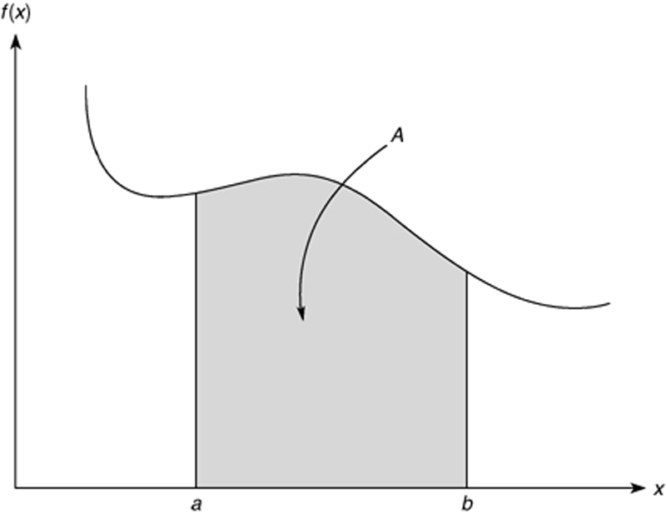

The Integral of f(x) Interpreted as the Area A Under the Curve of f(x) from x $=$ a to x $=$ b

Slide 4
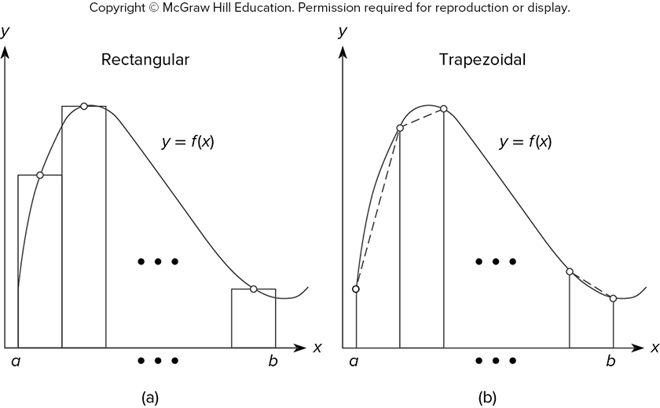
Illustration of (a) Rectangular and (b) Trapezoidal Numerical Integration
Access the text alternative for slide images.

Slide 5
Numerical Integration Functions 1
Command | Description
integral(fun,a,b) | Uses an adaptive Simpson’s rule to compute the integral of the function whose handle is fun, with a as the lower integration limit and b as the upper limit. The function fun must accept a vector argument.
trapz(x,y) | Uses trapezoidal integration to compute the integral of y with respect to x, where the array y contains the function values at the points contained in the array x.

Slide 6
Numerical Integration Functions 2
Although the integral function is more accurate than trapz, it is restricted to computing the integrals of functions and cannot be used when the integrand is specified by a set of points. For such cases, use the trapz function.

Slide 7
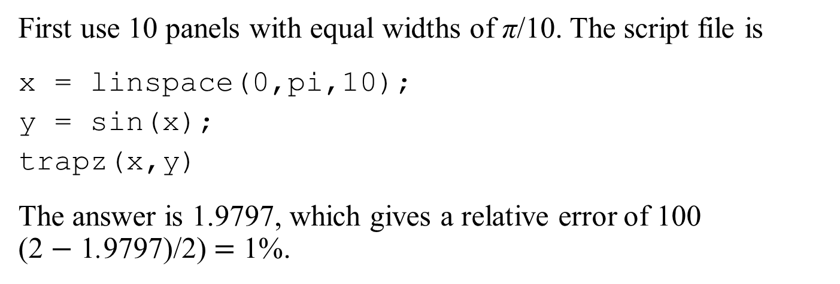
Numerical Integration Functions 3
Using the trapz function. Compute the integral
First use 10 panels with equal widths of π/10. The script file is
x = linspace(0,pi,10);
y = sin(x);
trapz(x,y)
The answer is 1.9797, which gives a relative error of 100 (2 $−$ 1.9797)/2) $=$ 1%.

Slide 8
Numerical Integration Functions 4
MATLAB function integral implements an adaptive version of Simpson’s rule. To compute the integral of sin(x) from 0 to π, type
>>A = integral(@sin,0,pi)
The answer given by MATLAB is 2.0000, which is correct.

Slide 9

Numerical Integration Functions 5
To integrate
from 0 to $√$(2π), create the function:
function c2 = cossq(x)
% cosine squared function.
c2 = cos(x.^2);
end
Note that we must use array exponentiation.
The integral function is called as follows:
>>integral(@cossq,0,sqrt(2*pi))
The result is 0.6119.

Slide 10
Polynomial Integration
q = polyint(p,C)returns a polynomial q representing the integral of polynomial p with a user-specified scalar constant of integration C.
Compute the indefinite integral of p(x) = 6x² – 7x + 10
q = polyint([6,-7,10])
q =
2.0000 -3.5000 10.0000 0
which corresponds to q = 2x³-3.5x²+10x+C after adding the constant of integration

Slide 11
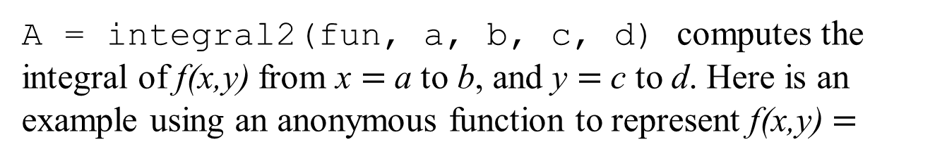
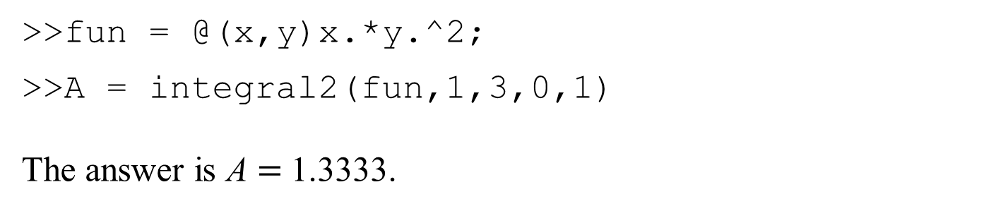
Double Integrals
A = integral2(fun, a, b, c, d) computes the integral of f(x,y) from x $=$ a to b, and y $=$ c to d. Here is an example using an anonymous function to represent f(x,y) $=$
>>fun = @(x,y)x.*y.^2;
>>A = integral2(fun,1,3,0,1)
The answer is A $=$ 1.3333.

Slide 12
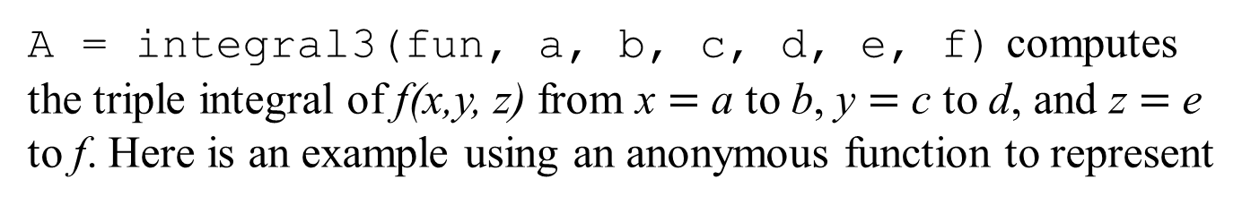
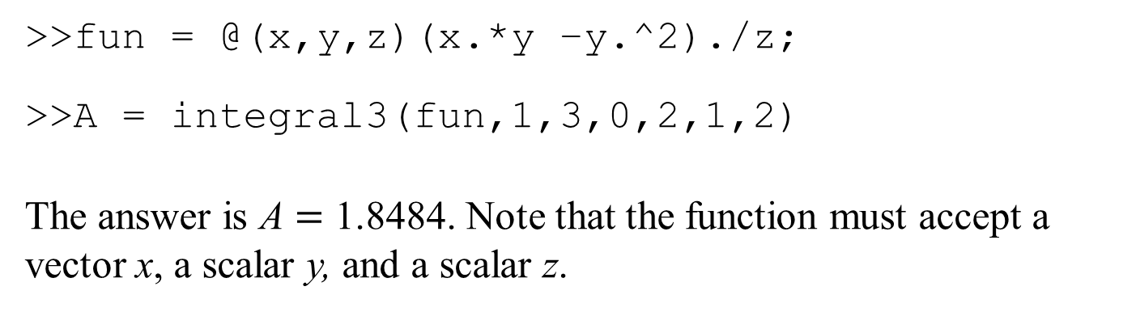
Triple Integrals
A = integral3(fun, a, b, c, d, e, f) computes the triple integral of f(x,y, z) from x $=$ a to b, y $=$ c to d, and z $=$ e to f. Here is an example using an anonymous function to represent
>>fun = @(x,y,z)(x.*y –y.^2)./z;
>>A = integral3(fun,1,3,0,2,1,2)
The answer is A $=$ 1.8484. Note that the function must accept a vector x, a scalar y, and a scalar z.

Slide 13


Use MATLAB to evaluate the following double integral:
fun = @(x,y)(x.^2+x.*y.^3);
A = integral2(fun, 0, 1, 1, 2) % ans → A = 2.2083
Use MATLAB to evaluate the following triple integral:
fun = @(x,y,z)(x.*y.*z);
V = integral3(fun, 2, 3, 1, 2, 0, 1) % ans → V = 1.8750

Slide 14
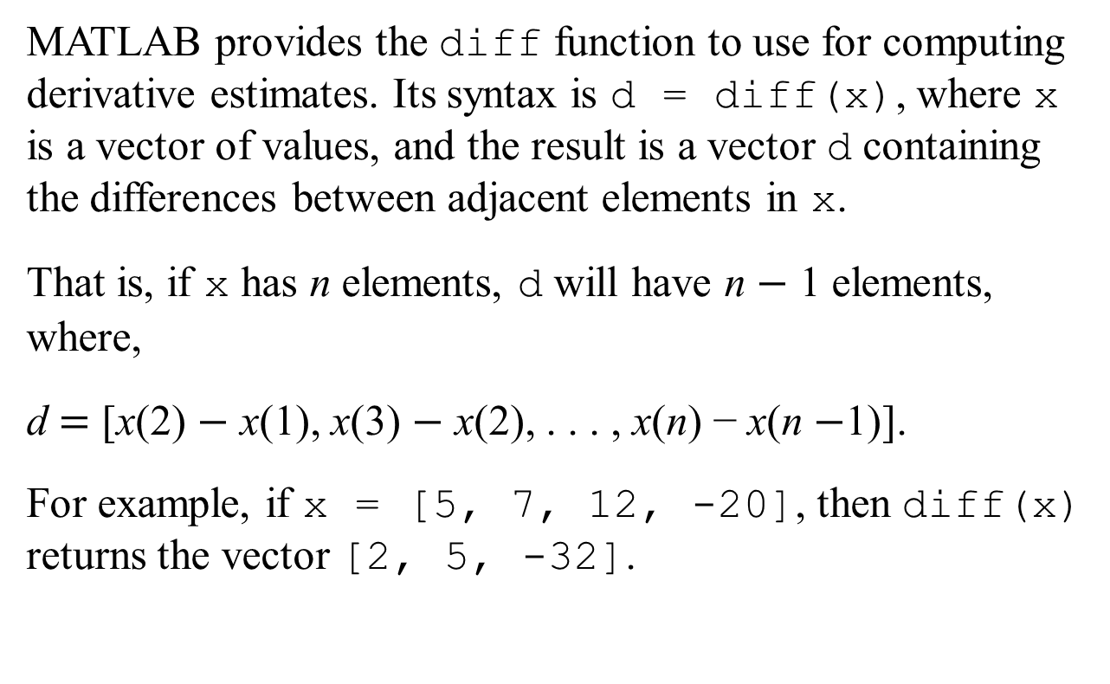
Numerical Differentiation
MATLAB provides the diff function to use for computing derivative estimates. Its syntax is d = diff(x), where x is a vector of values, and the result is a vector d containing the differences between adjacent elements in x.
That is, if x has n elements, d will have n $−$ 1 elements, where,
d $=$ [x(2) $−$ x(1), x(3) $−$ x(2), . . . , x(n) − x(n $−$1)].
For example, if x = [5, 7, 12, -20], then diff(x) returns the vector [2, 5, -32].

Slide 15
Polynomial Differentiation Functions
Command | Description
b = polyder(p) | Returns a vector b containing the coefficients of the derivative of the polynomial represented by the vector p.
b = polyder(p1,p2) | Returns a vector b containing the coefficients of the polynomial that is the derivative of the product of the polynomials represented by p1 and p2.
[num, den] = polyder(p2,p1) | Returns the vectors num and den containing the coefficients of the numerator and denominator polynomials of the derivative of the quotient p₂/p₁, where p1 and p2 are polynomials.

Slide 16
Computing Gradients
Typing
[df_dx, df_dy] = gradient(f,dx,dy)
computes the gradient of the function f(x,y), where df_dx and df_dy represent the partial derivatives, and dx, dy represent the spacing.

Slide 17
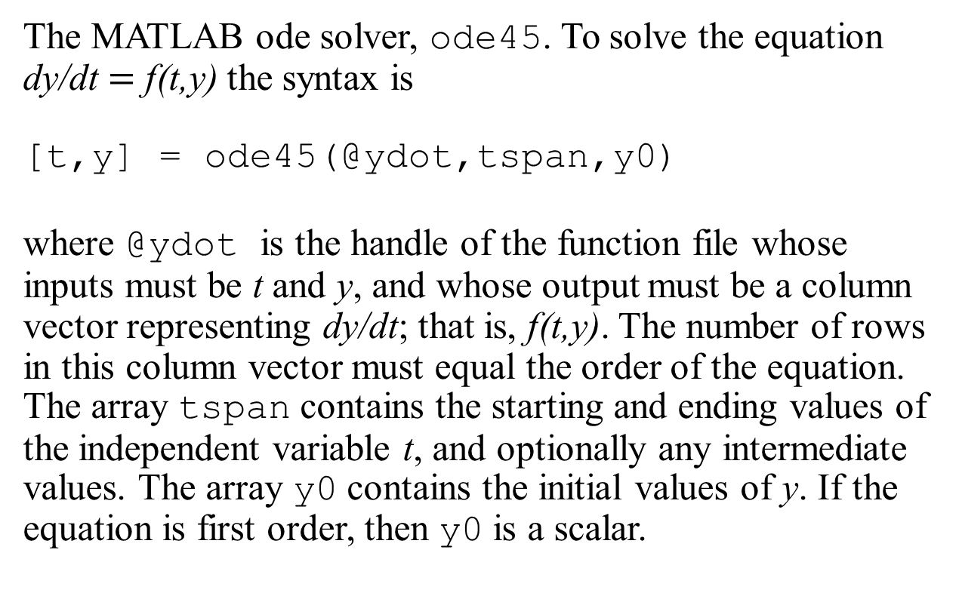
Solving First-Order Differential Equations
The MATLAB ode solver, ode45. To solve the equation dy/dt $=$ f(t,y) the syntax is
[t,y] = ode45(@ydot,tspan,y0)
where @ydot is the handle of the function file whose inputs must be t and y, and whose output must be a column vector representing dy/dt; that is, f(t,y). The number of rows in this column vector must equal the order of the equation. The array tspan contains the starting and ending values of the independent variable t, and optionally any intermediate values. The array y0 contains the initial values of y. If the equation is first order, then y0 is a scalar.

Slide 18
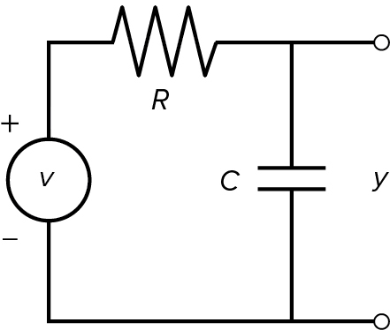
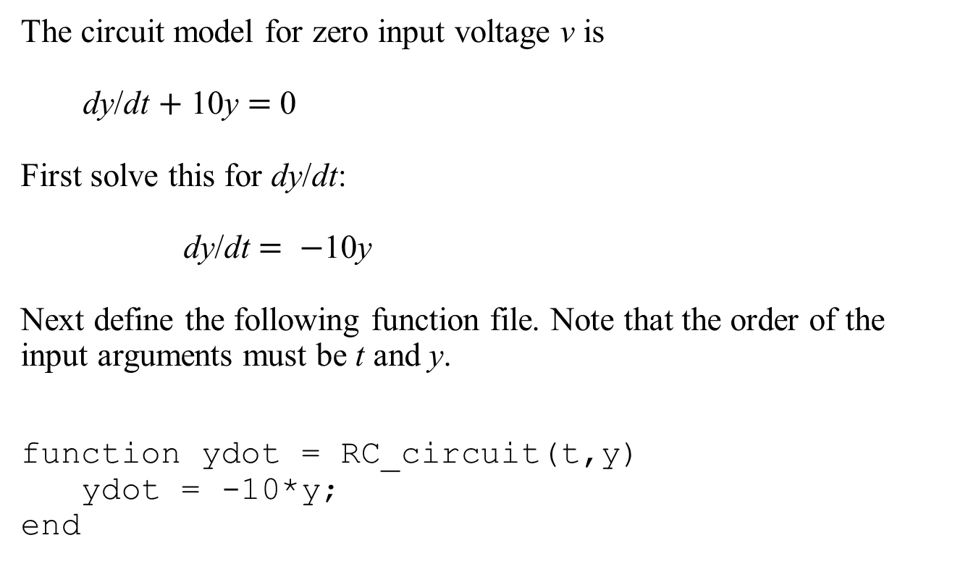
Response of an RC circuit
The circuit model for zero input voltage v is
dy/dt $+$ 10y $=$ 0
First solve this for dy/dt:
dy/dt $= −$10y
Next define the following function file. Note that the order of the input arguments must be t and y.
function ydot = RC_circuit(t,y)
ydot = -10*y;
end

Slide 19
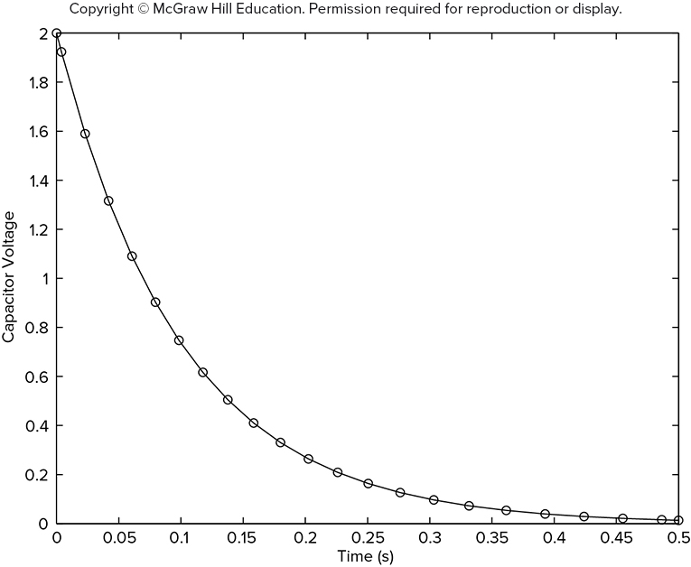
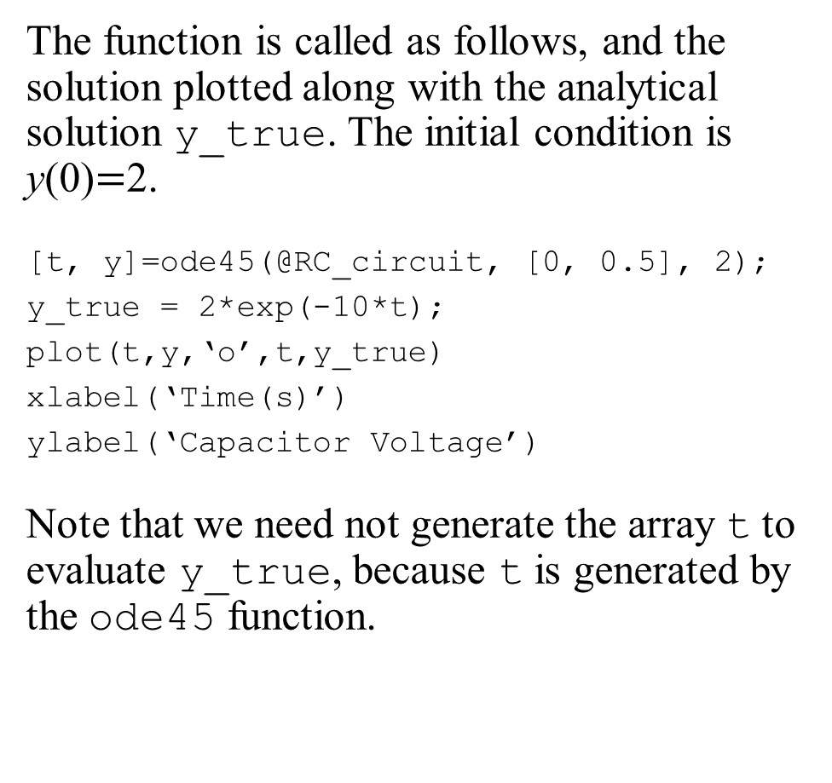
Response of an RC circuit
The function is called as follows, and the solution plotted along with the analytical solution y_true. The initial condition is y(0)$=$2.
[t, y]=ode45(@RC_circuit, [0, 0.5], 2);
y_true = 2*exp(-10*t);
plot(t,y,‘o’,t,y_true)
xlabel(‘Time(s)’)
ylabel(‘Capacitor Voltage’)
Note that we need not generate the array t to evaluate y_true, because t is generated by the ode45 function.

Slide 20

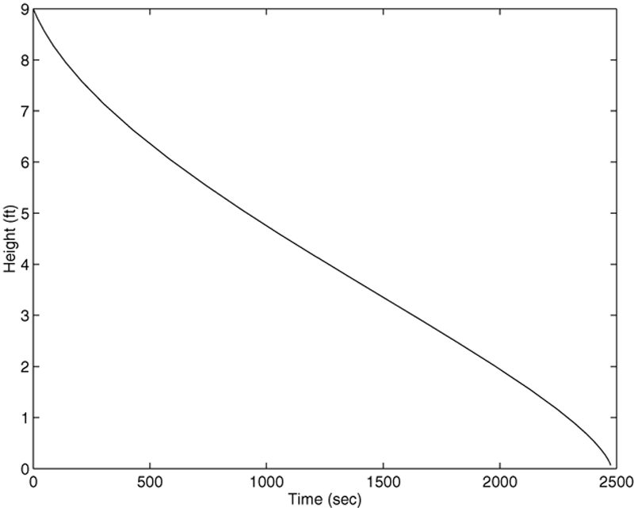
Nonlinear Example
Draining of a spherical tank.
The equation for the height is
First create the following function file.
function hdot = height(t,h)
Hdot = −(0.0344*sqrt(h))/(10*h−h^2);
end
This file is called as follows. The initial height is 9 ft.
[t,h] = ode45(@height, [0, 2475], 9);
plot(t,h),xlabel(‘Time(sec)’,ylabel(‘Height’(ft)’)

Slide 21


Extension to Higher-Order Equations
To use the ODE solvers to solve an equation higher than order 2, you must first write the equation as a set of first-order equations.
For example, consider the equation
Define
$=$ y and
$=$ dy/dt. Then the above equation can
be expressed as two equations:
This form is sometimes called the Cauchy form or the state-variable form.

Slide 22
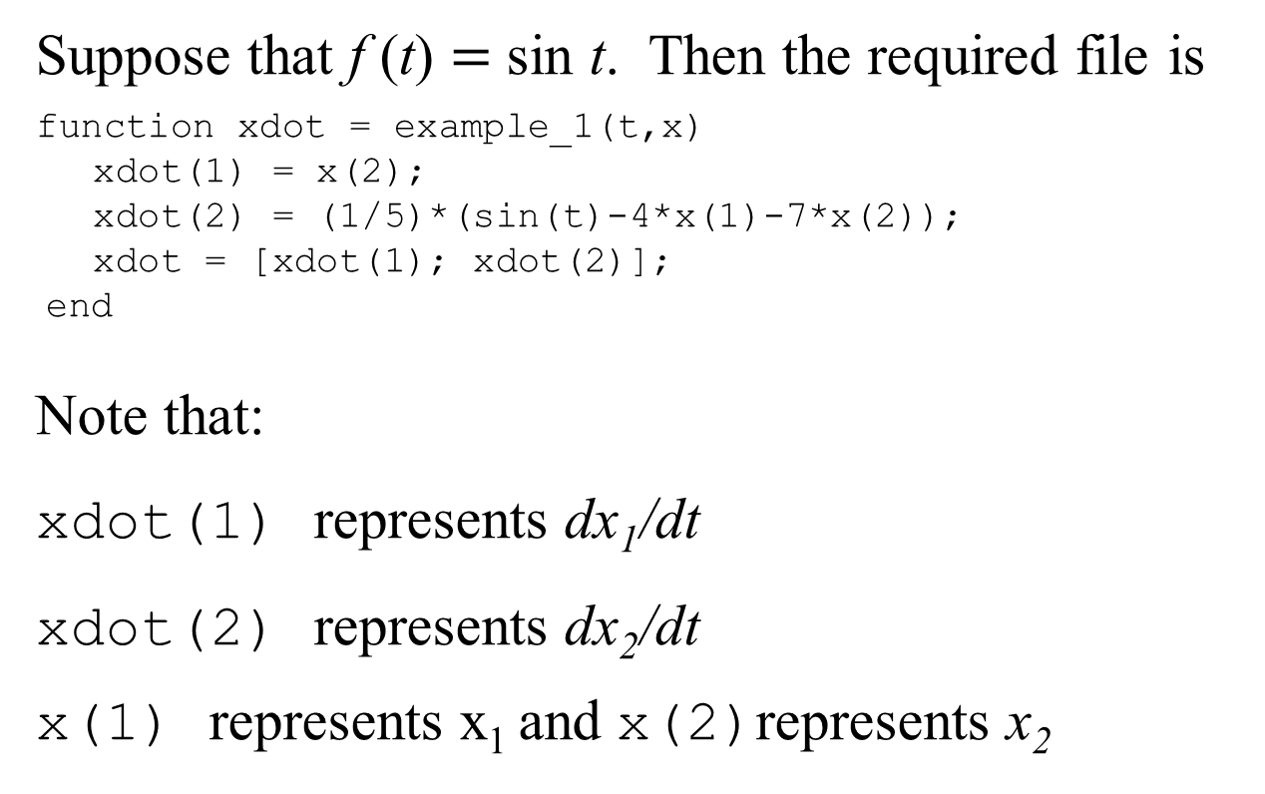
Extension to Higher-Order Equations
Suppose that f (t) $=$ sin t. Then the required file is
function xdot = example_1(t,x)
xdot(1) = x(2);
xdot(2) = (1/5)*(sin(t)-4*x(1)-7*x(2));
xdot = [xdot(1); xdot(2)];
end
Note that:
xdot(1) represents dx₁/dt
xdot(2) represents dx₂/dt
x(1) represents x₁ and x(2)represents x₂

Slide 23
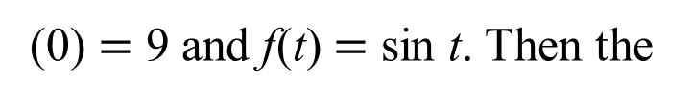
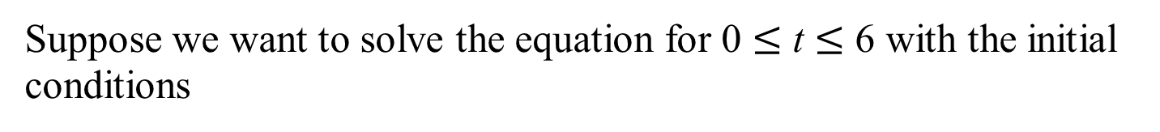
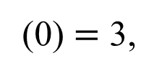
Extension to Higher-Order Equations
Suppose we want to solve the equation for 0 $≤$ t $≤$ 6 with the initial conditions
(0) $=$ 3,
(0) $=$ 9 and f(t) $=$ sin t. Then the
initial condition for the vector x is [3, 9]. To use ode45, you type [t, x] = ode45(@example_1, [0, 6], [3, 9]);
Each row in the vector x corresponds to a time returned in the column vector t. If you type plot(t,x), you will obtain a plot of both
and
versus t.
Note that x is a matrix with two columns; the first column contains the values of
at the various times generated by
the solver. The second column contains the values of
Thus, to plot only
type plot(t,x(:,1)).

Slide 24
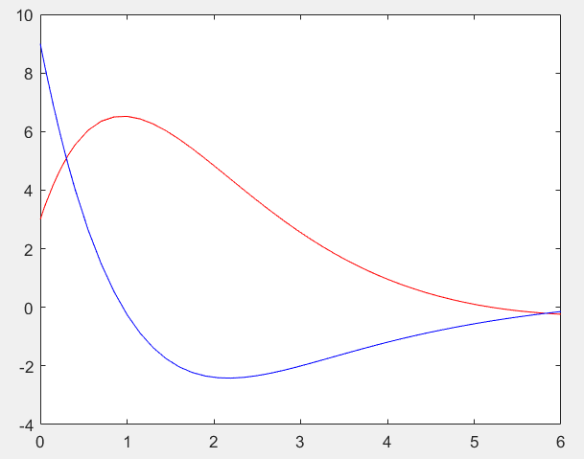
Extension to Higher-Order Equations

Slide 25
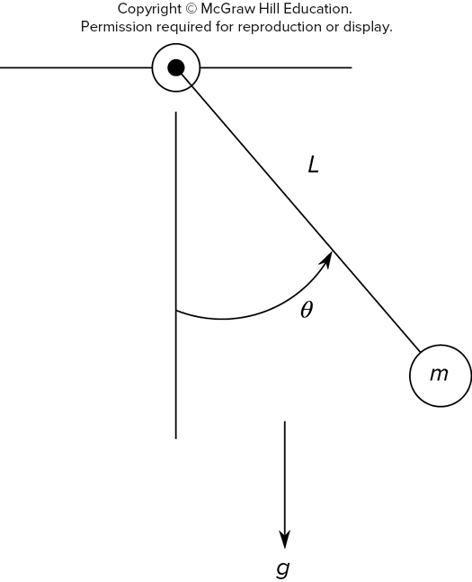
Pendulum Example - Nonlinear Model
The model is nonlinear and is
It must be rewritten as follows to use ode45.

Slide 26
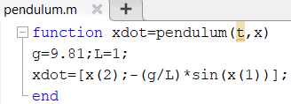
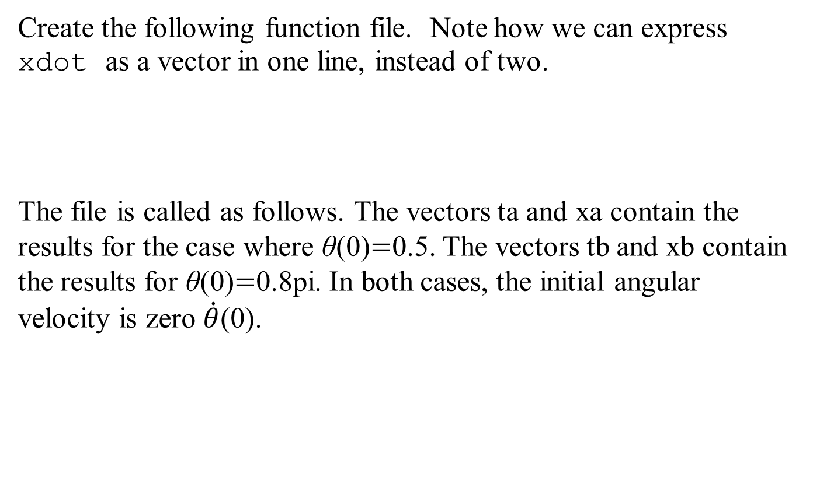
Nonlinear Model
Create the following function file. Note how we can express xdot as a vector in one line, instead of two.
The file is called as follows. The vectors ta and xa contain the results for the case where θ(0)$=$0.5. The vectors tb and xb contain the results for θ(0)$=$0.8pi. In both cases, the initial angular velocity is zero $\dot{θ}$(0).
% Pendulum Example - Non-linear Model
[ta,xa] = ode45(@pendulum, [0,5],[0.5,0]);
[tb,xb] = ode45(@pendulum, [0,5],[0.8*pi 0]);
plot(ta,xa(:,1),'r', tb,xb(:,1),'b')
xlabel('Time(s)')
ylabel('Angle(rad)')
gtext('case1')
gtext('case2')

Slide 27
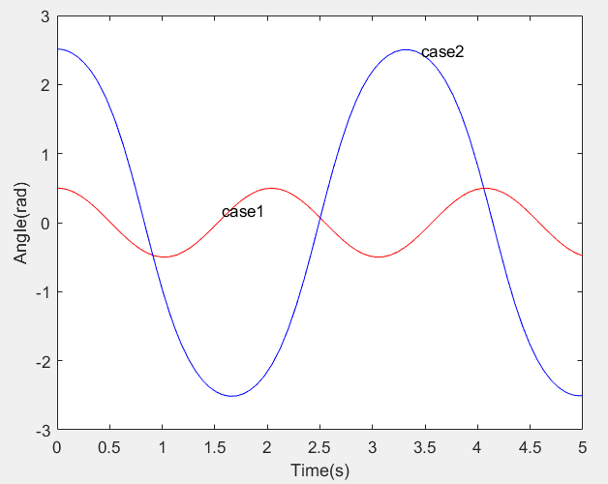
The Pendulum Angle as a Function of Time for Two Starting Positions

Slide 28
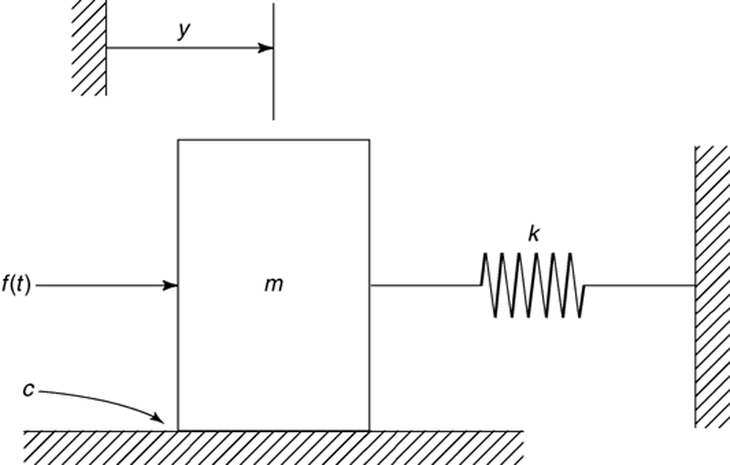
A Mass and Spring
A mass and spring with viscous surface friction. Its equation of motion is
Access the text alternative for slide images.

Slide 29

Special Methods for Linear Differential Equations
The equation of motion can be put into the following state variable form.
These can be put into matrix form as shown below.

Slide 30
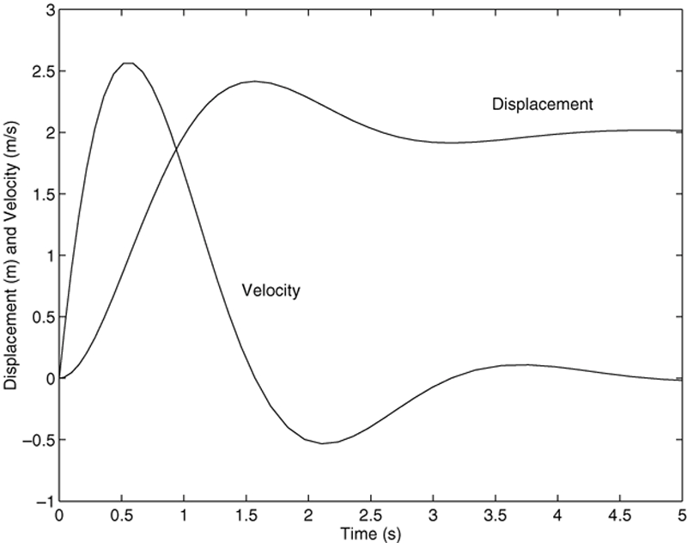

A Mass and Spring
function xdot = msd(t,x) u = 10; m = 1; c = 2; k = 5; A = [0, 1;−k/m, −c/m]; B = [0; 1/m]; xdot = A*x + B*u;
end
For$0≤t≤5, x_{1}\left(0\right)=0$and $x_{2}\left(0\right)=0$ The equations can be solved, and the solution plotted.
[t, x] = ode45(@msd, [0, 5], [0, 0]); plot(t, x(:,1), t, x(:,2))

Slide 31
Control Systems
A transfer function represents the relationship between the output signal of a control system and the input signal, for all possible input values.
Step response is the response to a system when the input is a step signal.
An impulse response means the output/behaviour of a system/process when we provide it with an impulse signal.

Slide 32
ODE Solvers in the Control System Toolbox The Step Function
Transfer function form: It is created by typing tf(right, left) where the vector right contains the coefficients on the right side of the equation and the vector left contains the coefficients on the left side. Consider the equation:
You create the transfer function model form named sys1 by typing
sys = tf([5, 1],[5, 7, 5]);
You can plot the unit step response for zero initial conditions by typing step(sys).
[x,t] = step(sys);
plot(t,x)

Slide 33
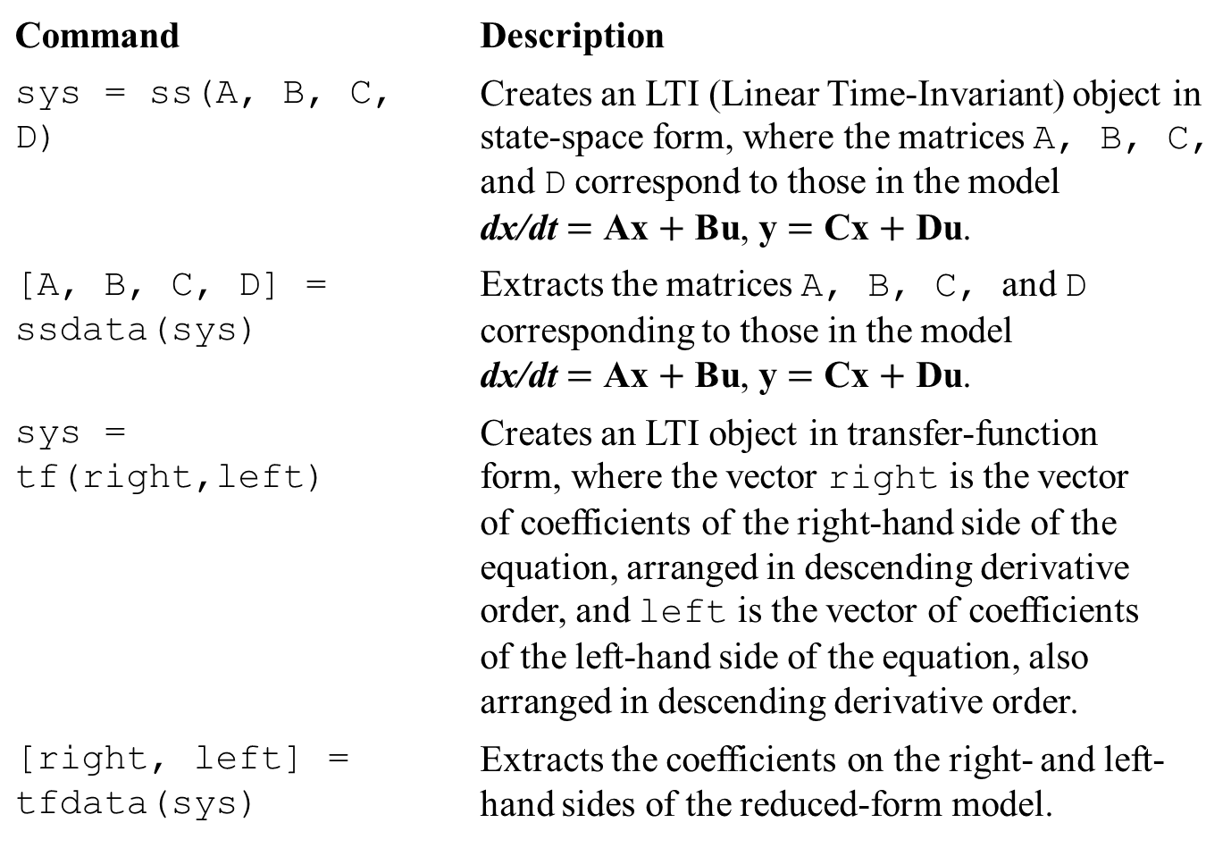
LTI Object Functions
Command | Description
sys = ss(A, B, C, D) | Creates an LTI (Linear Time-Invariant) object in state-space form, where the matrices A, B, C, and D correspond to those in the model dx/dt $=$ Ax $+$ Bu, y $=$ Cx $+$ Du.
[A, B, C, D] = ssdata(sys) | Extracts the matrices A, B, C, and D corresponding to those in the model dx/dt $=$ Ax $+$ Bu, y $=$ Cx $+$ Du.
sys = tf(right,left) | Creates an LTI object in transfer-function form, where the vector right is the vector of coefficients of the right-hand side of the equation, arranged in descending derivative order, and left is the vector of coefficients of the left-hand side of the equation, also arranged in descending derivative order.
[right, left] = tfdata(sys) | Extracts the coefficients on the right- and left-hand sides of the reduced-form model.

Slide 34
Basic Syntax of the LTI ODE Solvers
Command | Description
impulse(sys) | Computes and plots the unit-impulse response of the LTI object sys.
initial(sys,x0) | Computes and plots the free response of the LTI object sys given in state-model form, for the initial conditions specified in the vector x0.
lsim(sys,u,t) | Computes and plots the response of the LTI object sys to the input specified by the vector u, at the times specified by the vector t.
step(sys) | Computes and plots the unit-step response of the LTI object sys.

Slide 35
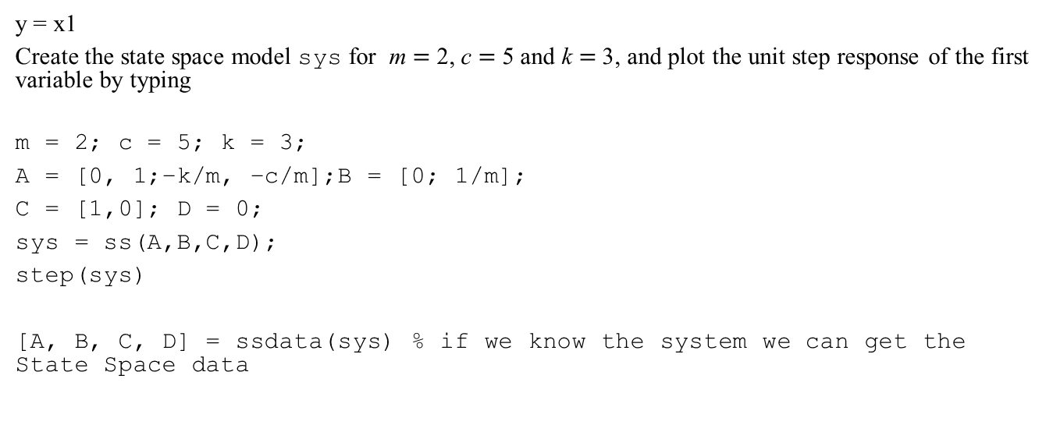
The State Variable Form Can Be Created with the ss Function
Consider the model
y = x1
Create the state space model sys for m $=$ 2, c $=$ 5 and k $=$ 3, and plot the unit step response of the first variable by typing
m = 2; c = 5; k = 3;
A = [0, 1;−k/m, −c/m];B = [0; 1/m];
C = [1,0]; D = 0;
sys = ss(A,B,C,D);
step(sys)
[A, B, C, D] = ssdata(sys) % if we know the system we can get the State Space data

Slide 36
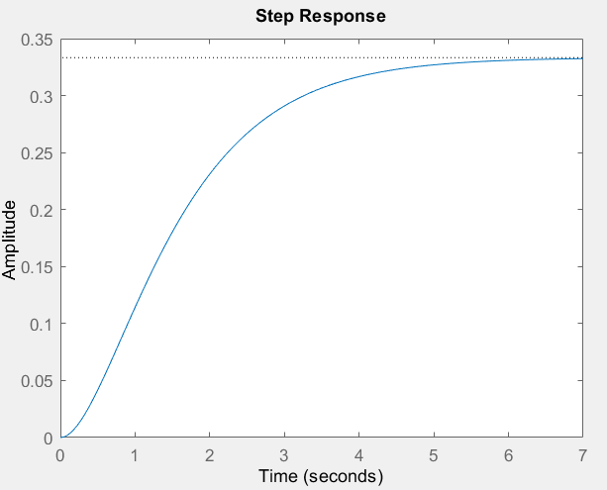

Slide 37
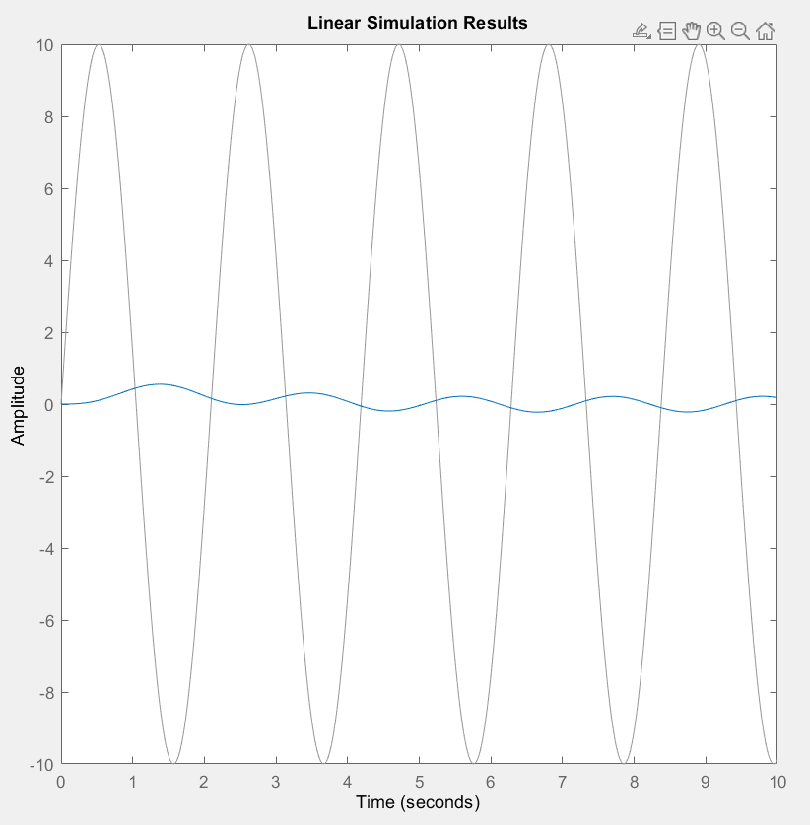
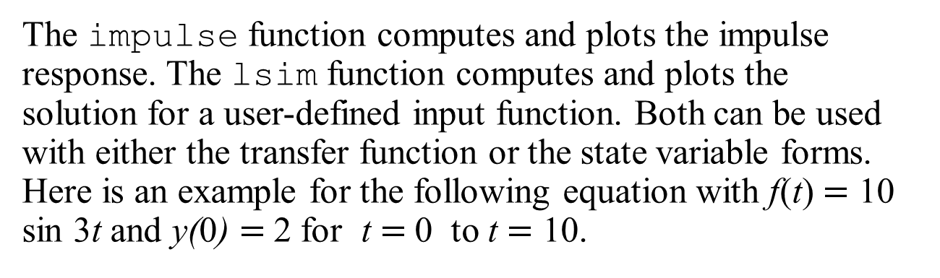
The impulse and lsim Funcions
The impulse function computes and plots the impulse response. The lsim function computes and plots the solution for a user-defined input function. Both can be used with either the transfer function or the state variable forms. Here is an example for the following equation with f(t) $=$ 10 sin 3t and y(0) $=$2 for t $=$0 to t $=$ 10.
sys = tf(1,[5,7,4]);
t = linspace(0,10,500);
f = 10*sin(3*t);
lsim(sys,f,t,2)

Slide 38
The initial Function
The command initial(sys,x0)computes and plots the free response of the LTI object sys given in state-model form, for the initial conditions specified in the vector x0. Initial conditions x₁(0) = 5, and x₂(0) = -2. For example,
m = 2; c = 3; k = 5;
A = [0, 1;−k/m, −c/m];
B = [0; 1/m];
C = [1,0]; D = 0;
sys = ss(A,B,C,D);
initial(sys, [5, -2])

Slide 39
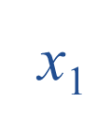
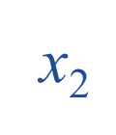
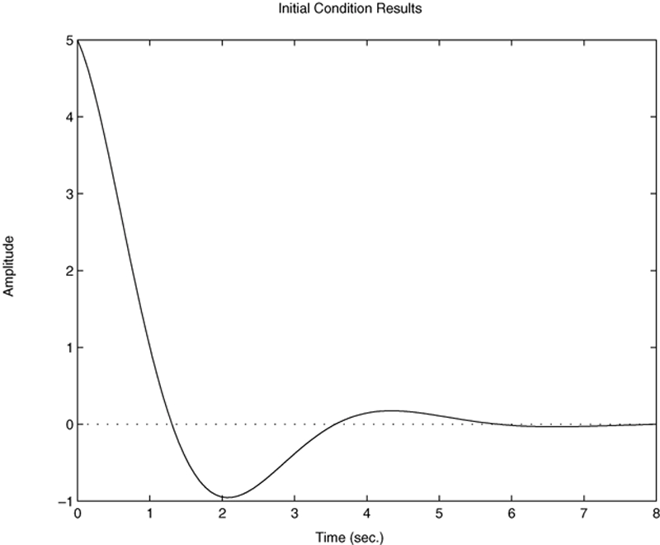

Free Response of the Model for x sub 1 (0) $=$ 5 and x sub 2 (0) $=−$2

Slide 40
Predefined Input Functions
The gensig function makes it easy to construct periodic input functions. The syntax is
[u,t] = gensig(type, period)
[u,t] = gensig(type, period, tF, dt)
where type can be ‘sin’, ‘square’, or ‘pulse’ and period is the desired period of the input. The vector t contains the times and the vector u contains the input values at those times. tF specifies the time duration of the input, and dt specifies the spacing between time instants.

Slide 41
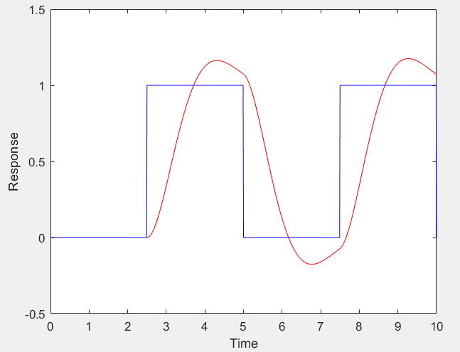

Square-Wave Response of the Model $\dot{\text{x}}$ . $+$ 2x $+$ 4x $=$ 4f
sys = tf(4,[1,2,4]);
[u, t] = gensig('square', 5, 10, 0.01);
[y, t] = lsim(sys, u, t);
plot(t,y,’r’,t,u,’b’);
axis([0 10 -0.5 1.5]);
xlabel('Time');
ylabel('Response');

Slide 42
End of Main Content
© McGraw Hill LLC. All rights reserved. No reproduction or distribution without the prior written consent of McGraw Hill LLC.

